Slide 1
Women in CMMI Meeting
EmpowerHER Future: From Capability to Impact Across Tech & Leadership
November 2025
Notes:
Lindsey

Slide 2
Agenda
November 2025 Meeting
Introduction
Speaker: Gabriela Da Cunha Arnold: IBM
Speakers: Alicia Rotindo and Patricia Brencher: ASRC Federal
House-Keeping
  Women in CMMI – Community Space
  Capability Creates 2026 – Save the Date!
  Short Survey
Open Q&A Session
Thank you!

Slide 3
Gabriela Da Cunha Arnold: IBM
Speaker

Slide 4
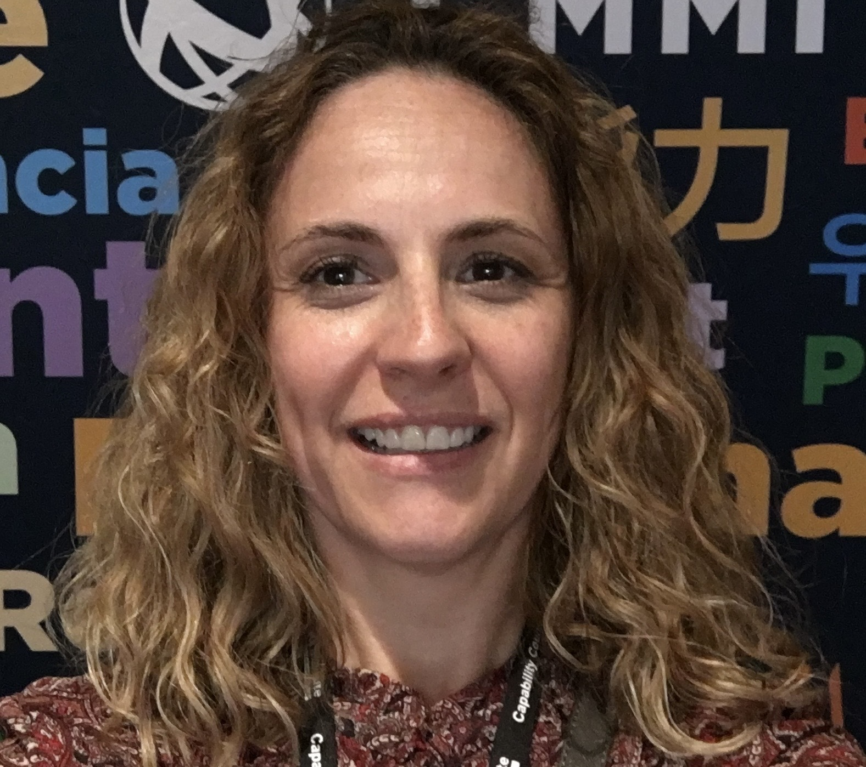
26+
Years Experience
IBM (Mexico / Ireland) –
12 yrs
European Software Institute (Spain) – 13 yrs
Unisinos University (Brazil) – 5 yrs
CMMI Journey
Consultant from 1995
Lead Appraiser in 2005
HM Lead Appraiser in 2008
Services / Acquisition in 2008
IBM BPOC since 2013
PAB Member 2020/2021
PAG Member 2024/2025
Data & Security in 2025
Models
PSP/TSP
CMM
CMMI
Areas of interest
Delivery Excellence
Leadership behaviors
Gen AI/Agentic
Complex Programs
Global Teams
Snapshot of my Profile
Key Skills & Competencies
Transformation Consultancy
Program & Project Management
Quality and Process Engineering
Client Centricity
People Management
Leadership & Coaching
Educational Qualifications
MSc Business Management– Innovation Strategies
BSc Systems Engineering
CMMI Certified High Maturity Lead Appraiser
Six Sigma
PMP
Scrum Master
IBM Services

Slide 5
Challenges & Reflection
Gender Bias & Stereotypes
Women may be perceived as less authoritative or less suited for leadership roles due to unconscious bias.
They are also more likely to be misinterpreted when giving feedback or raising concerns, sometimes being labeled as “emotional” even when communicating objectively.
Balancing Career and Family Expectations
Women often face disproportionate expectations around caregiving, which can make it more challenging to manage career progression, frequent travel, or demanding consultancy schedules.
Career ambition is questioned or moralized
A woman traveling for work may be judged for “leaving home,” while men are praised for dedication and commitment.
Her ambition can be moralized or viewed negatively.
Networking
Networking and client relationship-building are standard expectations in consultancy. For women, participating in these activities—especially alone—can be misinterpreted or judged differently.
Limited Sponsorship and Visibility
Women often have fewer opportunities for sponsorship or advocacy from senior leaders, which affects their visibility, access to high-profile work, and progression.

Slide 6
Alicia Rotindo & Patricia Brencher: ASRC Federal
Speakers

Slide 7



Women in CMMI
Alicia Rotindo, Patricia Brencher
November 18, 2025
ASRC Federal Proprietary

Slide 8
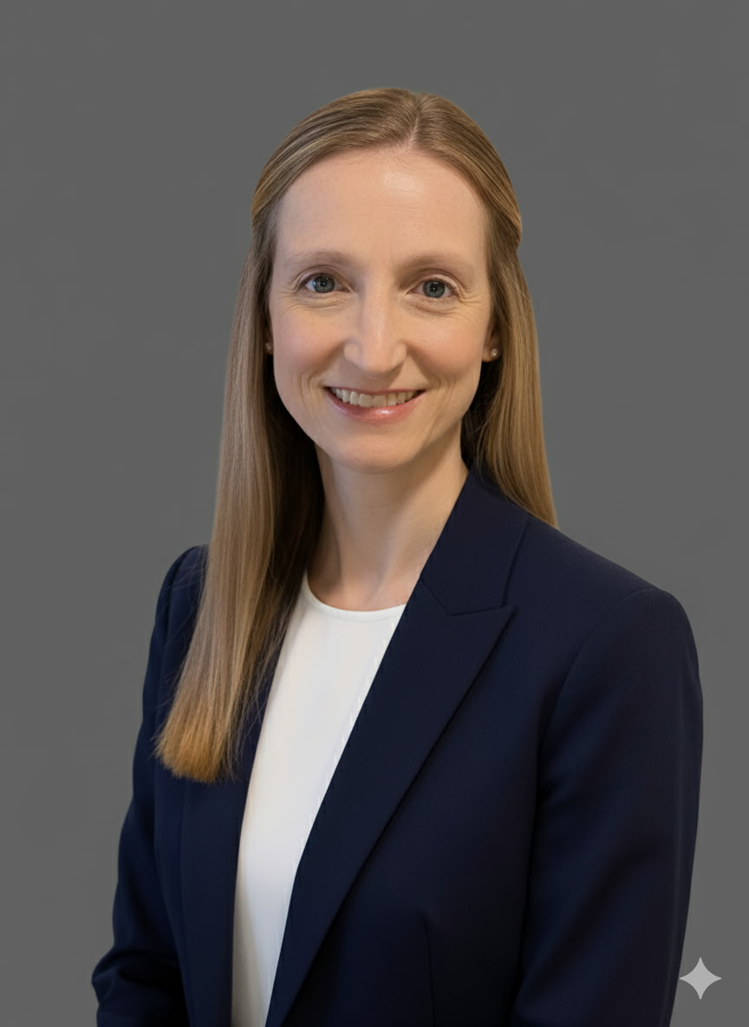
Alicia Rotindo
27 years of experience with CMM and CMMI Level 5 including ATM role
Current role as AFMS Metrics & Methodology Manager
Certified CMMI Practitioner
Certified Six Sigma Green Belt
Educational Background:
BS in Management and Information Systems
Graduate Certification in Data Analytics

Slide 9
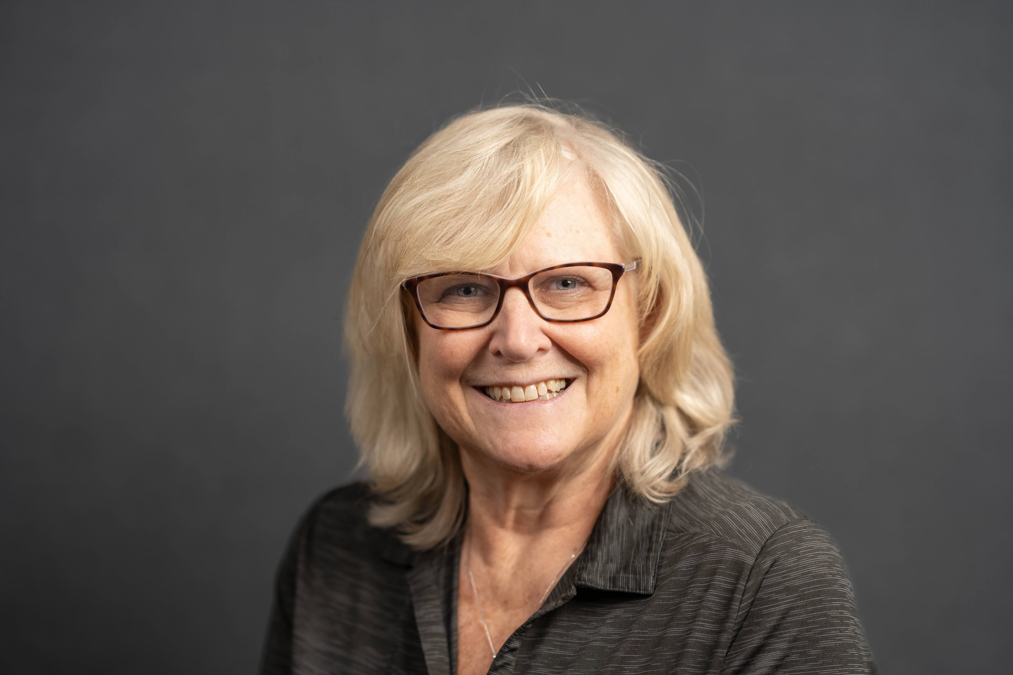
Patricia Brencher
22 years of experience with CMM and CMMI Level 5 including ATM role
Current role as AFMS Process & Product Quality Team Co-chair
Certified CMMI Practitioner
Educational Background:
BS in Computer and Information Science

Slide 10
AFMS CMM/CMMI Journey
11 consecutive CMMI Level 5 ratings from 2001 to 2024.
Demonstrates long-term commitment to process and product quality
CMM
CMMI
1994
2004
2014
2019
2024
2009
1999
1993-1997: CMM v1.1 Levels 2-3
12/1999: CMM v1.1 Level 4
3/2001: CMMI v1.0 Level 5
3/2003: CMMI v1.1 Level 5
3/2004: CMMI v1.1 Level 5
4/2006: CMMI v1.1 Level 5
5/2008: CMMI v1.2 Level 5
5/2011: CMMI v1.2 Level 5
5/2014: CMMI v1.3 Level 5 (Benchmark)
5/2017: CMMI v1.3 Level 5 (Benchmark)
5/2020: CMMI v2.0 Level 5 (Benchmark)
3/2023: CMMI v2.0 Level 5 (Sustainment)
11/2024: CMMI v3.0 Level 5 (Benchmark)

Slide 11
Lessons Learned & Takeaways
Why CMM/CMMI for ASRCF Mission Solutions?
  Initially, maintaining a CMM/CMMI for Development ML5 rating was a contractual requirement flowed down to us by our Prime contractor.
  Ongoing, CMMI ML1-3 is just what makes sense to repeatedly develop quality products and meet contractual delivery commitments.
  Ongoing, CMMI ML4-5 is the true quantitative management & continuous improvement part as tied to our annual operational goals.
What are the keys to success on any roadmap to CMMI L3 or L5?
  Senior Leadership team (SLT) buy-in and participation is paramount to success
  Must have dedicated resources (people, budget & tools) for a core implementation group
  Training fosters an ingrained culture of Process & Product Quality across engineering teams, project managers and support organizations.
What are the challenges for women when executing a CMMI roadmap?
  The same as on any other roadmap. You must have the above mentioned SLT buy-in, resources and an organizational training capability.

Slide 12
Alicia Rotindo
Metrics & Methodology Manager
e: arotindo@asrcfederal.com
p: (856) 291-2195
LinkedIn
121 Whittendale Drive
Moorestown, NJ 08057
Patricia Brencher
Senior Principal Process Analyst
e: pbrencher@asrcfederal.com
p: (856) 206-7519
121 Whittendale Drive
Moorestown, NJ 08057

Slide 13
House-Keeping

Slide 14
[NEW] Community Space – Women in CMMI
Coming Soon!
We heard your feedback last quarter—you wanted more opportunities to connect with other women in the CMMI community, and we’re making it happen!
We’re in the final stages of internal alignment before handing this over to IT to set up the group. Our approach will be twofold:
Internal Team & Advisory Panel UAT: We’ll conduct user acceptance testing to gather feedback and make refinements before the public rollout.
We anticipate launching at the start of Q1. This Community Space will be dedicated exclusively to women in the CMMI community and will serve as a pilot for future groups—such as partners, ATMs, and end-users—with additional sub-groups for specific topics and discussions.
A campaign to introduce our first CMMI Community Space will kick off in the coming weeks. Stay tuned—we’re excited to bring this to life!

Slide 15
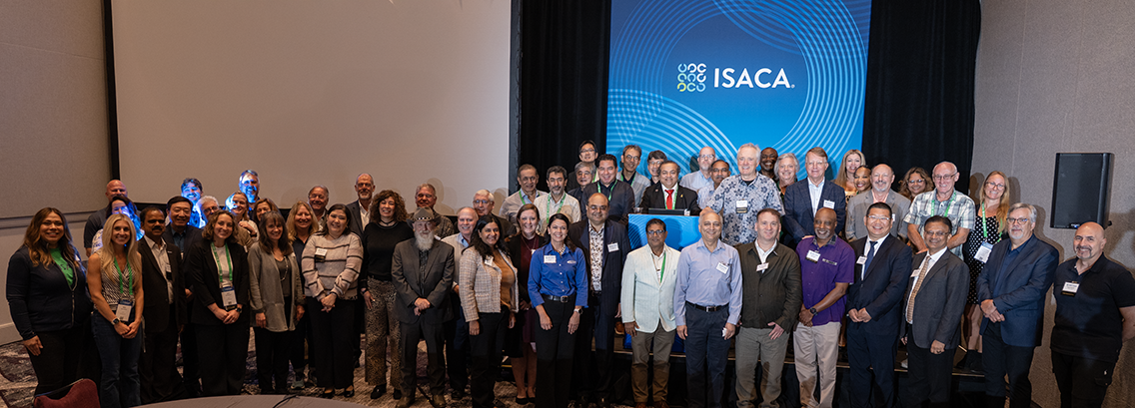
Capability Creates 2026
June 23-24, 2026
CMMI is excited to host our annual Conference in Washington, D.C., at The Dupont Circle Hotel—and this year, we’re opening it up to our ATMs and end-user community!
Our team is actively preparing the agenda and will share details soon. Expect dynamic sessions featuring:
Women in CMMI and Government Leadership
AI and Emerging Technologies
Crosswalks Between Standards
Real-World Case Studies from End-Users
Choosing the Right Domain for Your Organization
Save the date and mark your calendars—we can’t wait to see you there!
If you have any questions, please reach out to lmarshall@isaca.org.

Slide 16

End of Year Survey: Women in CMMI
Please complete the survey within the next few days - your feedback is invaluable in shaping next year’s Women in CMMI meetings!

Slide 17

Open Q&A Session
This is an opportunity to ask questions to our speakers, Advisory Panel, or CMMI via unmuting or chat. This is a way to seek advice, and discuss relevant topics.
Reminder: This session is a safe, confidential space and will not be recorded. You're welcome to share only if you feel comfortable. Please be respectful of others and their perspectives - every voice matters.
As always, please don't hesitate to reach out after the meeting (lmarshall@isaca.org).

Slide 18
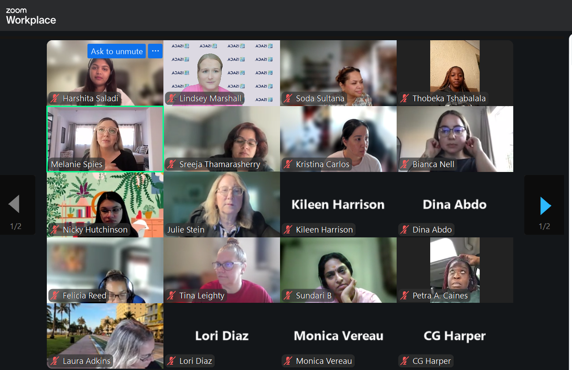
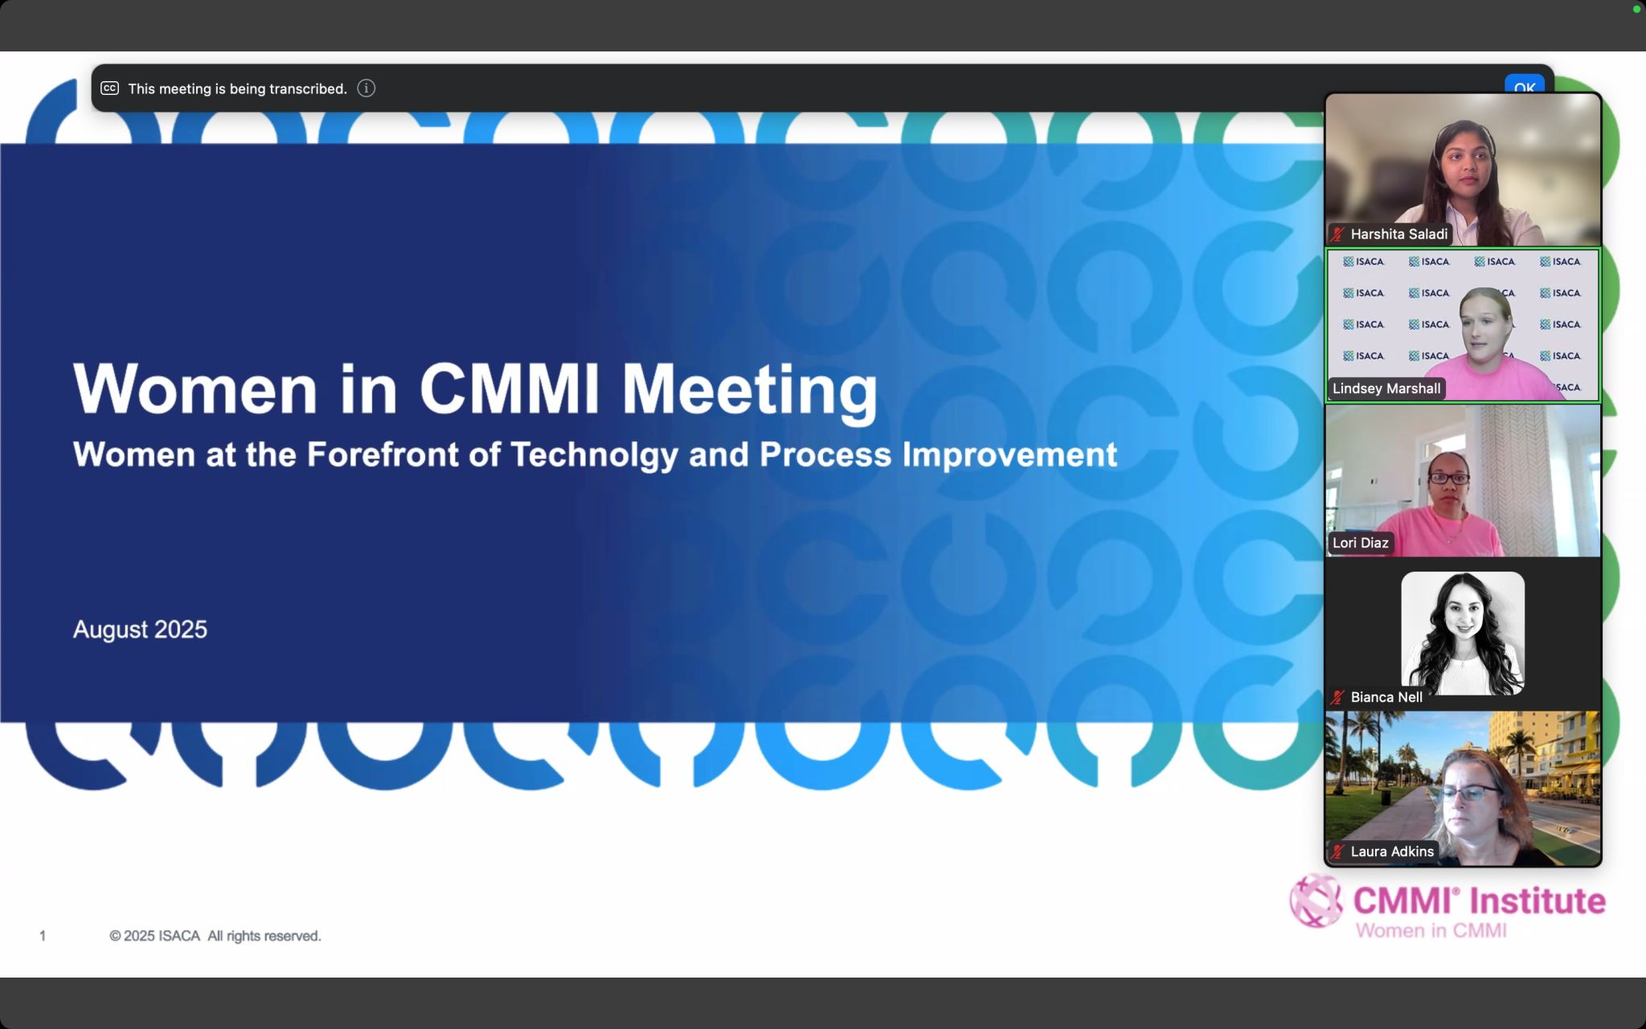
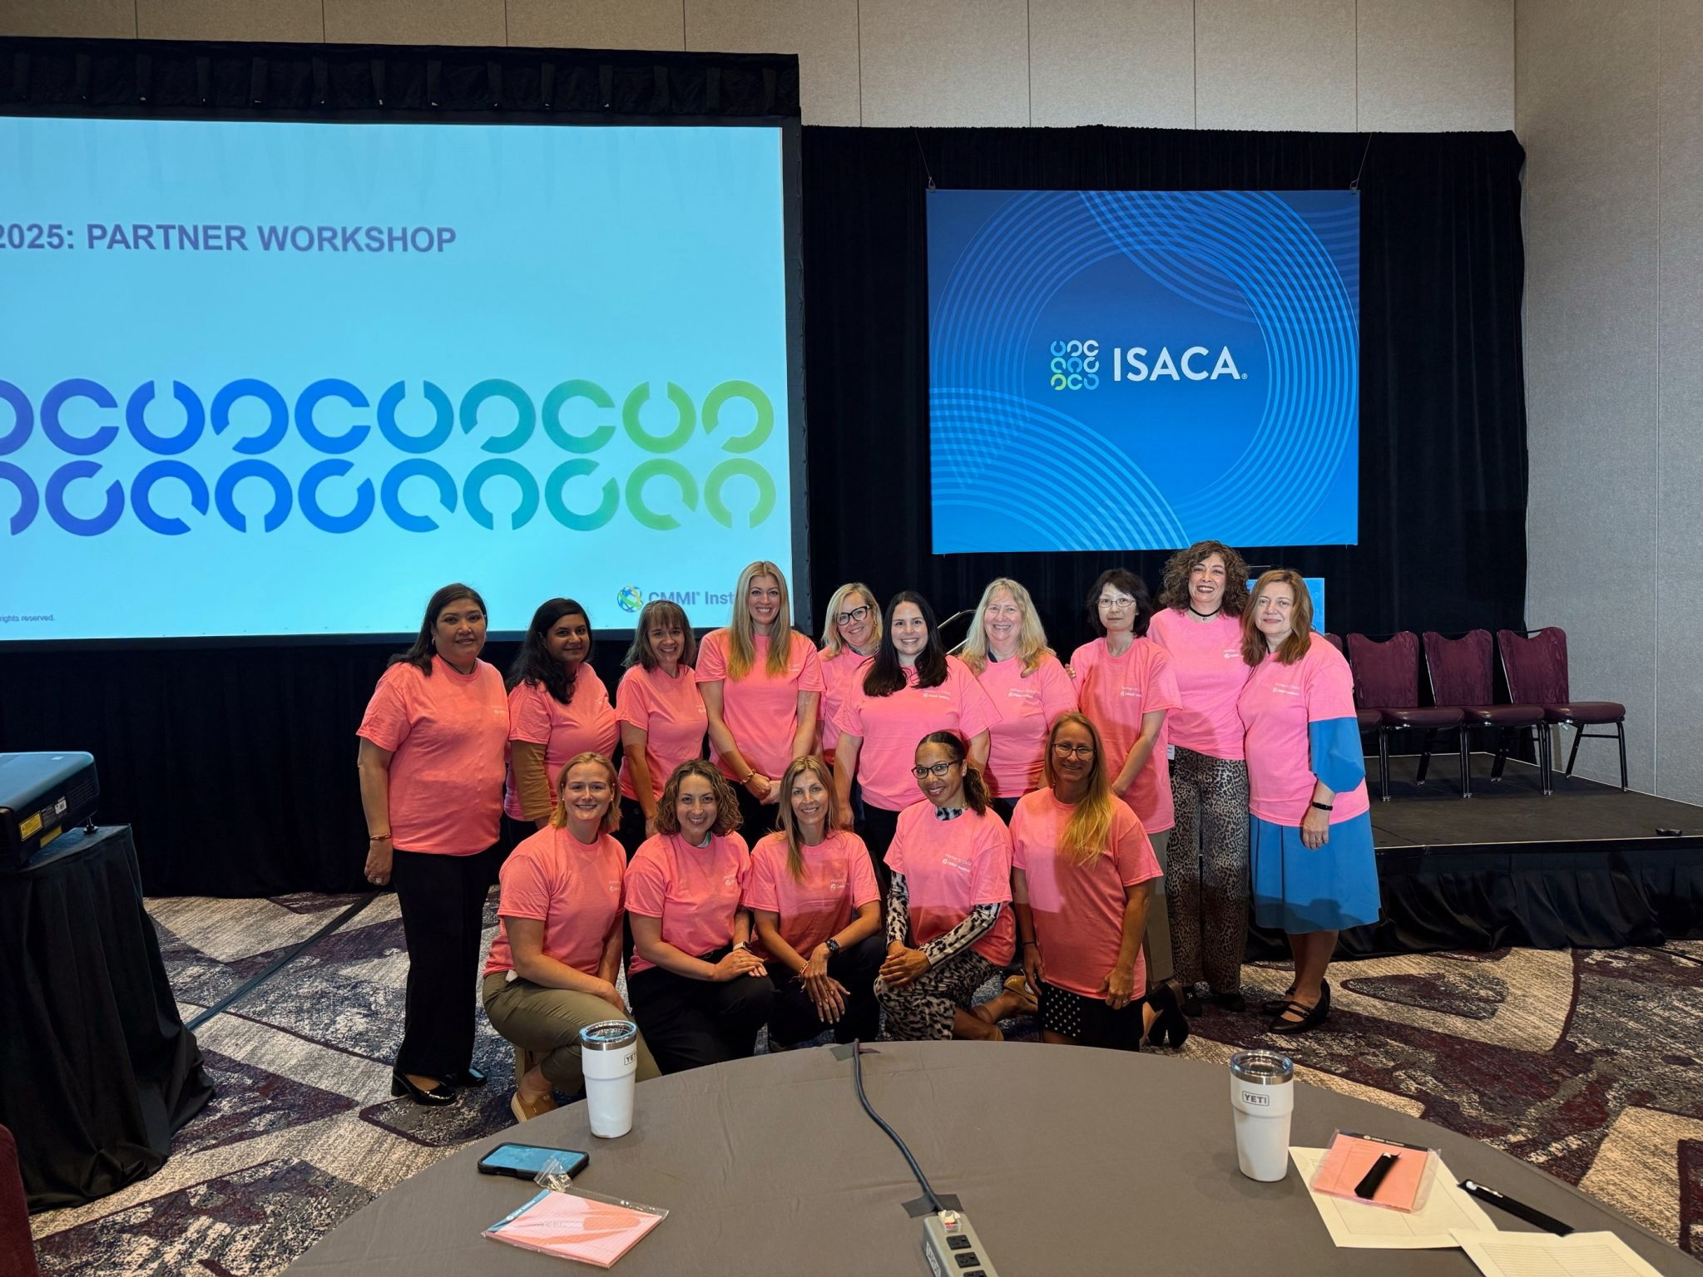
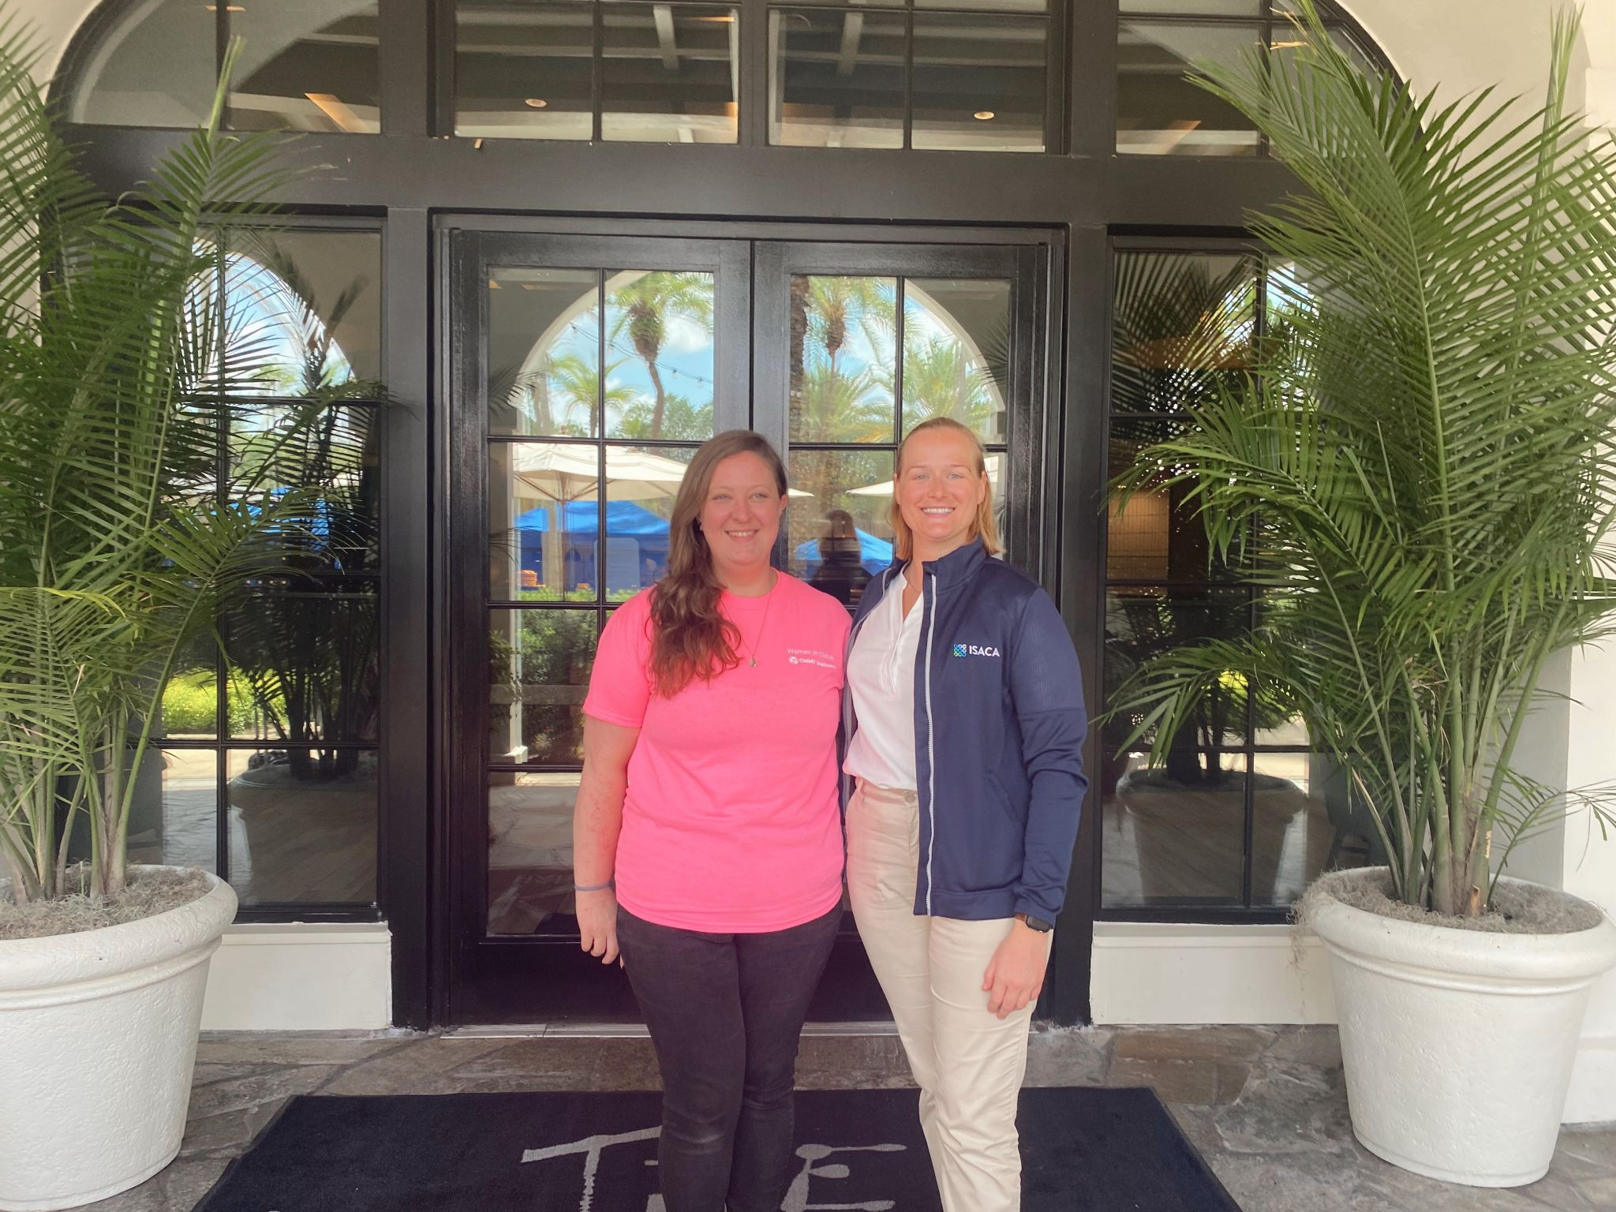
Thank you for being part of Women in CMMI this year—we appreciate your engagement and look forward to seeing you next year!

Slide 19
Notes:
All

